Slide 1
Chapter three
Random-Number Generation

Slide 2
Random-Number Generation
is a computational or physical device designed to generate a sequence of numbers or symbols that cannot be reasonably predicted better than by a random chance..
A sequence in which each term is unpredictable.
A random number is a number chosen as if by chance from some specified distribution.
Random numbers are numbers that occur in a sequence such that two conditions are met:
Computer generated "Random Numbers" are used in many applications.
Ex. Design game

Slide 3
Random-Number Generation
Random numbers are a necessary basic ingredient in the simulation of almost all discrete systems.
Most computer languages have a subroutine, object, or function that will generate a random number.
Similarly simulation languages generate random numbers that are used to generate event limes(tool for simulation of multiprocessors) and other random variables.
Random number generators produce a flow of numbers that
Are observations from a continuous uniform distribution between 0 and 1
Are independent of each other

Slide 4
Application area of Random Numbers
Simulation
Simulate natural phenomena
Sampling
It is often impractical to examine all possible cases, but a random sample will provide insight into what constitutes typical behavior
Numerical analysis
Computer programming
Decision making
“Many executives make their decisions by flipping a coin…”
Recreation
Design games

Slide 5
Properties of Random Numbers
Two important statistical properties:
Uniformity
Independence.
Each Random Number, R_{i}, must be independently drawn from a continuous uniform distribution between zero and 1. That is the pdf is given by:

Slide 6
Some consequences of the uniformity and independence properties are the following:
If the interval (0,1) is divided into n classes, or subintervals of equal length, the expected number of observations m each interval is N/n where N is the total number of observations.
The probability of observing a value in a particular interval is of the previous values drawn

Slide 7
Three Types of Random Numbers
Pseudorandom numbers are numbers that appear random, but are obtained in a deterministic, repeatable, and predictable manner.
True random numbers are generated in non-deterministic ways. They are not predictable. They are not repeatable.
Quasi-Random is a series of numbers satisfying some mathematical random properties even though no random appearance is provided

Slide 8
Generation of Pseudo-Random Numbers
Pseudo” means false, so false random numbers are being generated.
The goal of any generation scheme is to produce a sequence of numbers between zero and 1 which simulates, or initiates, the ideal properties of uniform distribution and independence as closely as possible.
When generating pseudo-random numbers, certain problems or errors can occur. . Some examples include the following
The generated numbers may not be uniformly distributed.
The generated numbers may be discrete -valued instead continuous valued
The mean of the generated numbers may be too high or too low.
The variance of the generated numbers may be too high or low
There may be dependence. The following are examples:
Autocorrelation between numbers.
Numbers successively higher or lower than adjacent numbers
Several numbers above the mean followed by several numbers below the mean

Slide 9
Important considerations in RN routines
Fast
Portable to different computers
Have sufficiently long cycle
Replicable
Closely approximate the ideal statistical properties of uniformity and independence.

Slide 10
Techniques for Generating Random Numbers
Linear Congruential Method (LCM).
Combined Linear Congruential Generators (CLCG).
Random-Number Streams.

Slide 11
Linear Congruential Method
To produce a sequence of integers, X₁, X₂, … between 0 and m-1 by following a recursive relationship:
The selection of the values for a, c, m, and X₀ drastically affects the statistical properties and the cycle length.
The random integers are being generated [0,m-1], and to convert the integers to random numbers:
The multiplier
The increment
The modulus

Slide 12
The initial value X₀ is called the seed, a is called the constant multiplier, c is the increment, and m is the modulus.
If c ≠0, then the form is called the mixed congruential method.
When c = 0, the form is known as the multiplicative congruential method.
EXAMPLE 3.1
Use the linear congruential method to generate a sequence of random numbers with X₀ = 27, a= 17, c = 43, and m = 100.
Here, the integer values generated will all be between zero and 99 because of the value of the modulus.
These random integers should appear to be uniformly distributed the integers zero to 99.Random numbers between zero and 1 can be generated by
Ri =Xi/m, i= 1,2,…… (3.1)

Slide 13
The sequence of X_{i} and subsequent R_{i} values is computed as follows:
X₀ = 27
X₁ = (17.27 + 43) mod 100 = 502 mod 100 = 2
R₁=2⁄100=0. 02
X₂ = (17 • 2 + 43) mod 100 = 77 mod 100 = 77
R₂=77 ⁄100=0. 77
X₃ = (17•77+ 43) mod 100 = 1352 mod 100 = 52
R₃=52 ⁄100=0. 52
Maximal period can be achieved by the proper choice of a, c, m, and X₀

Slide 14
Example 3.2
Using the multiplicative congruential method, find the period of the generator for a=13, m=2⁶=64, and X₀= 1, 2, 3, and 4.
The solution is given in table 3.1. When the seed is 1 and 3, the sequence has period 16. However, a period of length eight is achieved when the seed is 2 and a period of length four occurs when the seed is 4.
In example 3.2, m=2⁶ =64 and c=0. The maximal period is there fore P=m/4=16.
Notice that this period is achieved using odd seeds X₀=1 and X₀=3, but even seeds X₀=2 and X₀=4, yield periods of eight and four, both less than maximum.

Slide 15
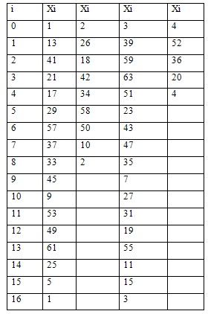

Slide 16
Tests for Random Numbers
The desirable properties of random numbers are uniformity and independence.
To insure that these desirable properties are achieved, a number of tests can be performed.
Here The five types of tests are
Frequency test:-the chi- square test to compare the distribution of the set of numbers generated to a uniform distribution
Runs test:- the runs above, and below the mean by comparing the actual values to expected values
Autocorrelation test: -Tests the correlation between numbers and compares the sample correlation to the expected correlation
Gap test:- Counts the number of digits that appear between repetitions of particular digit
Poker test: - Treats numbers grouped together as a poker hand.

Slide 17
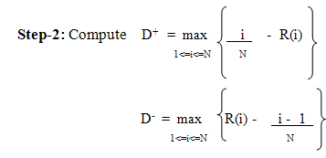
Frequency Tests
Two different methods of testing are available. They are
Kolmogorov-Smirnov
chi-square test.
For testing against a uniform cdf, the test procedure step as follows
Step-1: Rank the data from smallest to largest. Let R (i) denote the ith smallest observation, so that R (1) <= R (2) <= • • • <= R (N)
Step-3: Compute D = max (D+, D-).

Slide 18
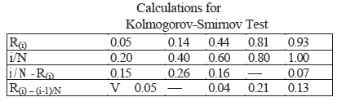
Step-4: Determine the critical value, Dα, Let α=0.05.
Step-5: If the sample statistic D is greater than the critical value, Dα, the null hypothesis that the data are a sample from a uniform distribution is rejected.
EXAMPLE
Suppose that the five numbers 0.44, 0.81, 0.14, 0.05, 0.93 were generated, and it is desired to perform a test for uniformity using the Kolmogorov-Smirnov test with a level of significance a of 0.05
First, the numbers must be ranked from smallest to largest. The calculations can be facilitated by use the following table

Slide 19
The top row lists the numbers from smallest (R(1) ) to largest (R(n)
The computations for D+, namely i /N -R(i} and for D-, namely R(i ) - ( i - l ) / N, are easily accomplished using the above table
The statistics are computed as D+ = 0.26 and D- = 0.21. Therefore, D = max {0.26, 0.21} = 0.26.
The critical value of D, obtained from Table A.8 for a = 0.05 and N =5, is 0.565.
Since the computed value, 0.26, is less than the tabulated critical value, 0.565, the hypothesis of no difference between the distribution of the generated numbers and the uniform distribution is not rejected.

Slide 20
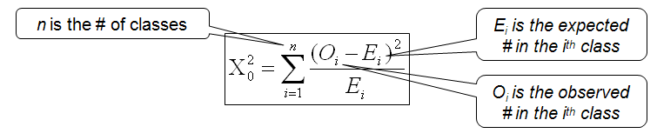
The chi-square test
The chi-square test uses the sample statistic
Ei the expected number in each class is given by Ei = N/n
Where N is the total # of observation
Approximately the chi-square distribution with n-1 degrees of freedom (where the critical values are tabulated in Table A.6)
EXAMPLE 3.6
Use the chi-square test with α = 0.05 to test whether the data shown below are uniformly distributed
The test uses n = 10 intervals of equal length, namely [0, 0.10), [0.11, 0.20), . . . , [0.91, 1.0).

Slide 21
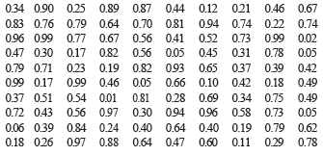
Interval | O_{i} | E_{i} | O_{i} -E_{i} | ( O_{i} -E_{i} )² | ( O_{i} -E_{i} )² / E_{i}
1 (0-.10) | 08 | 10 | -2 | 4 | 0.4
2 (.11- .20) | 08 | 10 | -2 | 4 | 0.4
3 (.21- .30) | 10 | 10 | 0 | 0 | 0.0
4 (.31- .40) | 09 | 10 | -1 | 1 | 0.1
5 (.41- .50) | 12 | 10 | 2 | 4 | 0.4
6 (.51- .60) | 08 | 10 | -2 | 4 | 0.4
7 (.61- .70) | 10 | 10 | 0 | 0 | 0.0
8 (.71- .80) | 14 | 10 | 4 | 16 | 1.6
9 (.81- .90) | 10 | 10 | 0 | 0 | 0.0
10 (.91- 1.00) | 11 | 10 | 1 | 1 | 0.1
The value of X₀² is 3.4. This is compared with the critical value X²_{0.05,9} =16.9. Since X₀² is much smaller than the tabulated value of X² _{0.05,9} , the null hypothesis of a uniform distribution is not rejected.

Slide 22
Runs Tests
Runs up and runs down. The runs test examines the arrangement of numbers in a sequence to test the hypothesis of independence.
Before defining a run, a look at a sequence of coin tosses will help with some terminology. Consider the following sequence generated by tossing a coin 10 times:
H T T H H T T T H T
There are three mutually exclusive outcomes, or events, with respect to the sequence.
The first head is preceded by no event and the last tail is succeeded by no event. Every sequence begins and ends with no event.
A run is defined as a succession of similar events preceded and followed by a different event.
There are two possible concerns in a runs test for a sequence of number. The number of runs is the first concern and the length of runs is a second concern.

Slide 23
The types of runs counted in the first case might be runs up and runs down.
An up run is a sequence of numbers each of which is succeeded by a larger number.
Similarly, a down run is a sequence of numbers each of which is succeeded by a smaller number.
To illustrate the concept, consider the following sequence of 15 numbers
-0.87 +0.15 +0.23 +0.45 -0.69 -0.32 -0.30 +0.19 -.24 +0.18 +0.65 +0.82 -0.93 +0.22 0.81
The numbers are given a “+” or a “— “depending on whether they are followed by a larger number or a smaller number.
Since there are 15 numbers, and they are all different, there will be 14 +'s and —’s.
The last number is followed by "no event" and hence will get neither a + nor a —. The sequence of 14 +s and —’s as follows:
- + + + - - - + - + + - +
Each succession of +’s and —’s forms a run. There are eight runs. The first run is of length one. The second and third are of length three, and so on. Further, there are four runs up and four runs down.

Slide 24
These two extremes can be formalized as follows: if N is the number of numbers in a sequence, the maximum number of runs is N —1 and the minimum number of runs is one.
If a is the total number of runs in a truly random sequence, the mean and variance of a are given by
μa = 2N – 1 / 3 (3.4)
and
σ²_{a} = 16N – 29 / 90 (3.5)
For N > 20, the distribution of a is reasonably approximated by a normal distribution, N ( μa , σ² a) This approximation can be used to test the independence of numbers from a generator.
In that case the standardized normal test statistic is developed by subtracting the mean from the observed number of runs, a, and dividing by the standard deviation. That is, the test statistic is
Z₀ = a - μa / σa
Substituting Equation (3,4) for μa and the square root of Equation (3.5) for σa yields
Z₀ = a - [( 2N - 1)/3] / sqrt((16N – 29) / 90 )

Slide 25
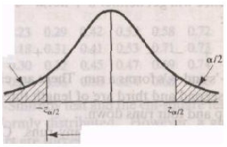
Where Z₀ ~ N(0, 1). Failures to reject the hypothesis of independence occur when — Z α / 2 <= Z₀<= Zα / 2 where α is the level of significance. The critical values and rejection region are shown in the following Figure

Slide 26

Example 3.8
Based on run up and run down determine whether the following sequence of 40 numbers is such that the hypothesis of independence can be rejected where σ= 0.05
The sequence of runs up and down is as follows
+ + + - + - + - - - + + - + - - + - + - - + - - + - + + - - + + - + - - + + -
There are 26 run in this sequence. N = 40 and a = 26 so
μa = 2(40) – 1 / 3 = 26.33
and
σ²_{a} = 16(40) – 29 / 90 = 6.79
Then
Z₀ = a - μa / σa. Z₀ = 24 – 26.33 / sqrt 6.79 = -0.89
Now, the critical value is z₀ 0.025=1.96, so the independence of the numbers cannot be rejected on the base of this test.

Slide 27
Assignment
Discuss briefly with example Run above and below the mean.
Discuss briefly with example test length of run.
Discuss briefly with example test for Autocorrelation.
Discuss briefly with example poker test.
Discuss briefly with example gap test.

Slide 28
Thank You ?

